Slide 1
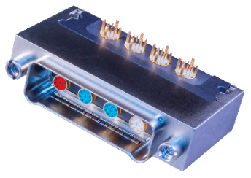
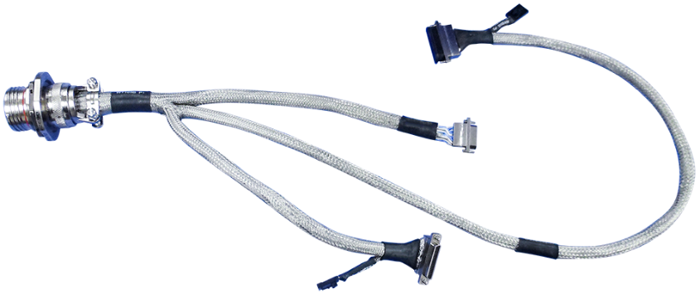
Missile and Collaborative Combat System Interconnect Solutions
Connectors and Assemblies for Autonomous Battlespace Applications
Notes:
SWaP optimization
extreme shock and vibration resistance
high-speed data
power distribution
EMI protection
sealed interconnects
rapid production scalability
harsh-environment survivability

Slide 2
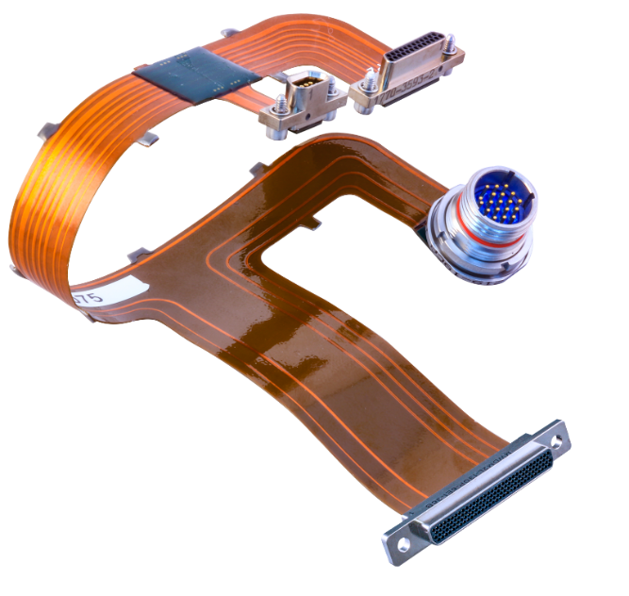
Mission-Critical Interconnect Solutions
For missiles and unmanned combat aircraft
Turnkey interconnect assemblies with Glenair signature
wire and cable
Rugged connectors for high-power and high-frequency applications
Interconnect technology for electromagnetic compatibility
Small form-factor interconnects for size and weight reduction
Harsh environmental aerospace and missile launch connectors
High-density rectangular cable, board, and backplane connectors
Innovative wire protection connector accessories

Slide 3


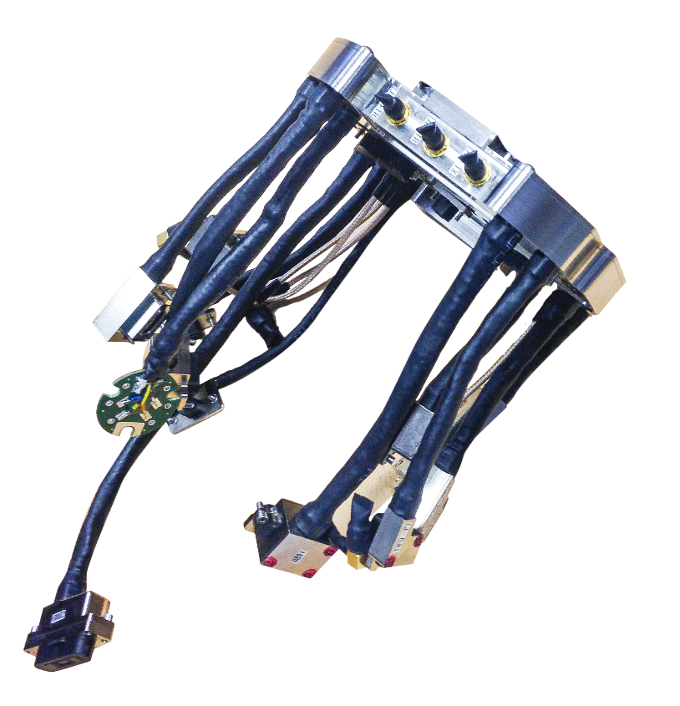

Turnkey Interconnect Assemblies

Slide 4
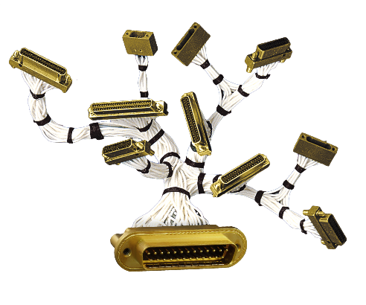
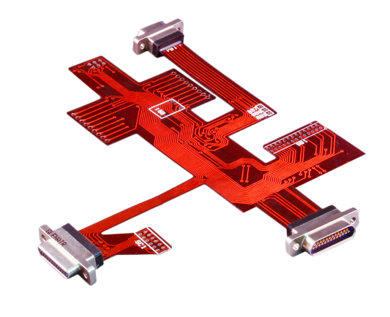
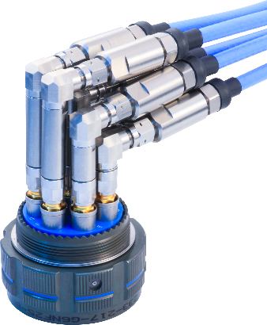
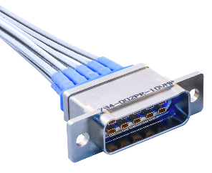
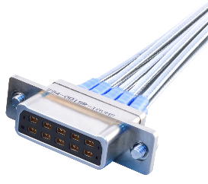
Turnkey Cable and Conduit Assemblies
Built with Glenair signature wire and cable
MIL-STAR™
sensor/control
SuperFlex™
integrated PCB flex,
rigid, and optical
SpeedLine™
high-speed
controlled impedance
BluMark RF™
high-frequency coax

Slide 5
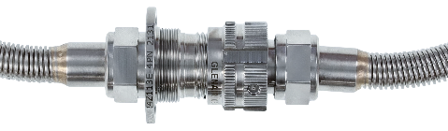
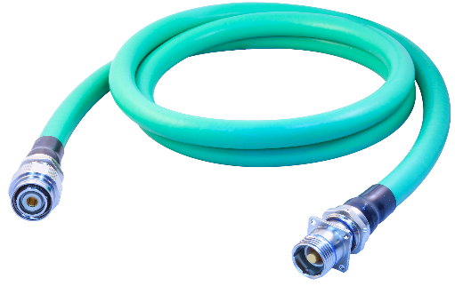
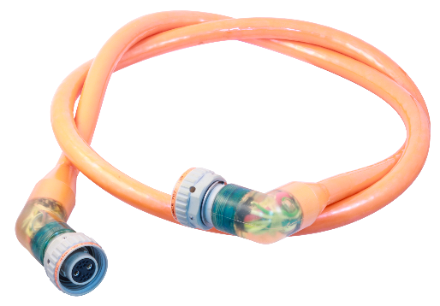
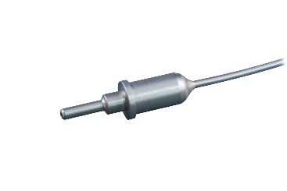
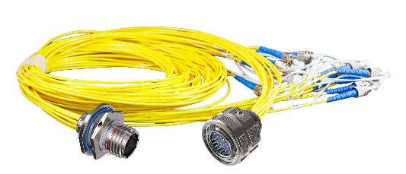
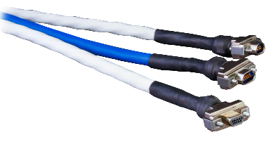
Turnkey Cable and Conduit Assemblies
Built with Glenair signature wire and cable
FiberKing™
mil-aero fiber optic
TurboFlex™
high-flexibility power
SeaKing
10K psi subsea
High-temp, cryo, gas tube, space-grade

Slide 6
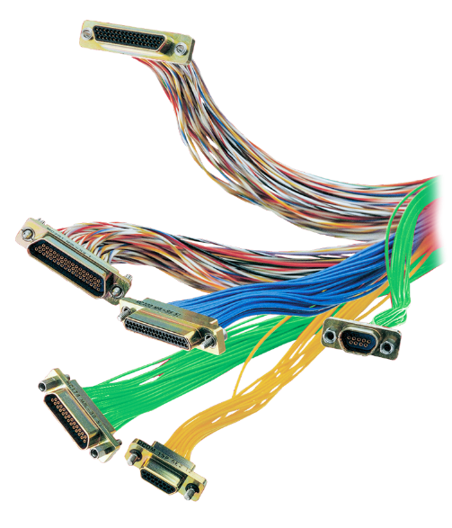

MIL-STAR GS22759 Aerospace-Grade Wire
IAW SAE AS22759 batch testing and documentation
Hookup wire and GS27500 multi-conductor cable
In-house crosslinked XL-ETFE
Low-fluoride space-grade PNs
Red plague-resistant 80µ silver plating
Signature lightweight braid PNs
In-stock availability, no minimums
Notes:
Our MIL-STAR low-speed signal wire and multiconductor cables for hookup and harness equipment applications are perfectly positioned to drive growth in high-density complex cable assembly business, due to these six major strengths.

Slide 7
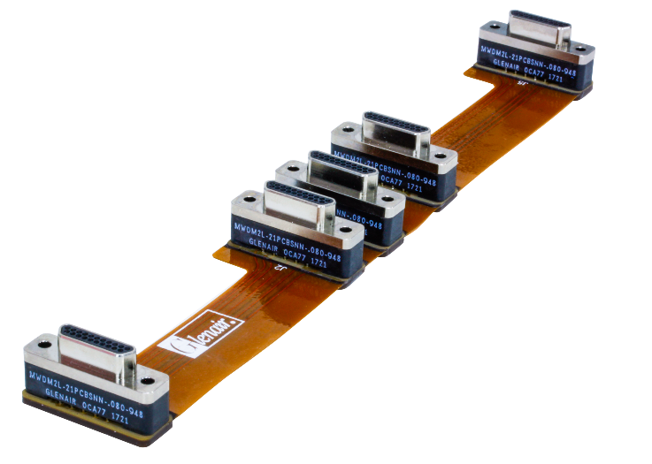
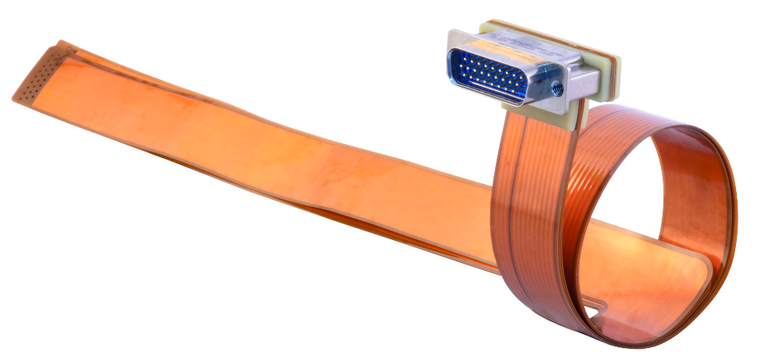
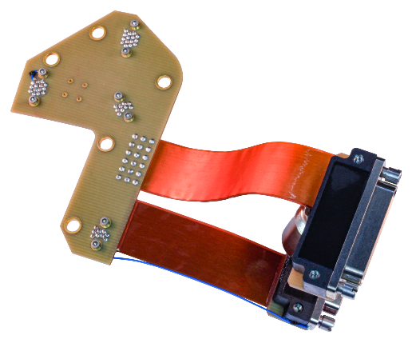

Connectorized Flex and Rigid-Flex Assemblies
Integrated electrical and optical designs
Flex
Rigid flex
Long length

Slide 8
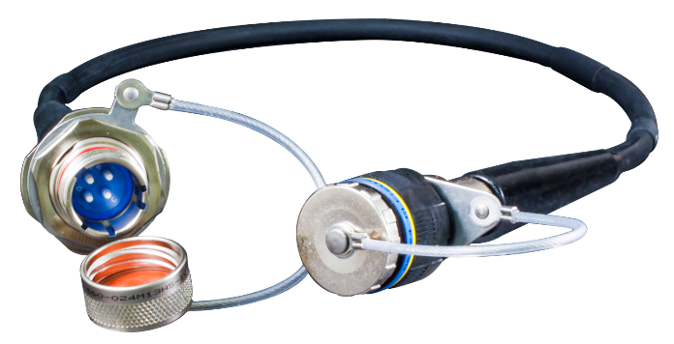
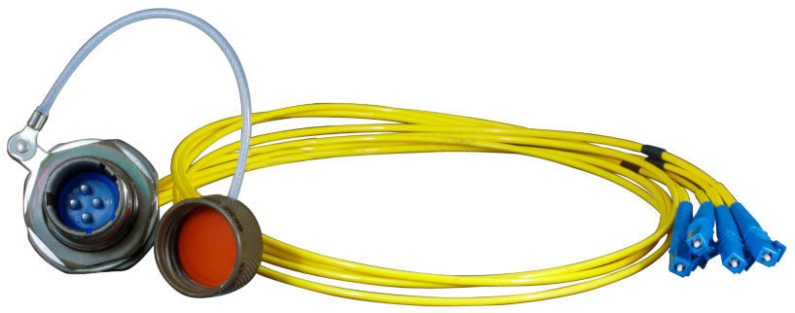
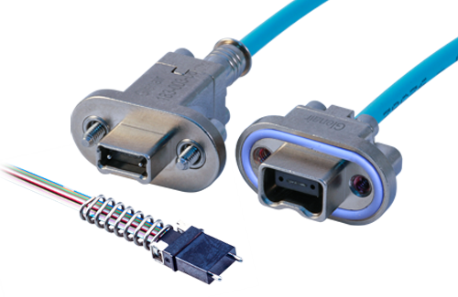

Fiber Optic Wire, Cable, and Harnesses
Lightweight · High datarate · EMI / RFI immunity
Rugged overmolded
Inside-the-box
High-density MT

Slide 9
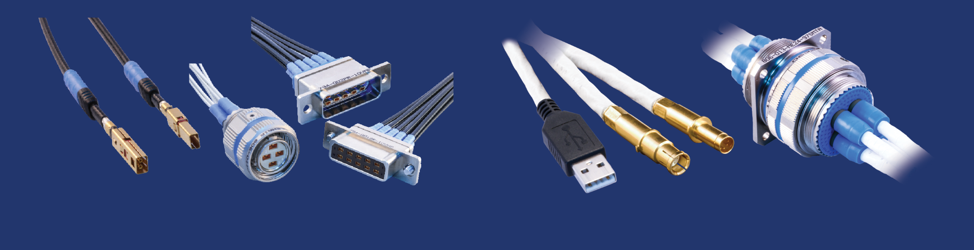

High-Speed Controlled-Impedance Cables
Turnkey assemblies optimized for 10Gb Ethernet and other
high-datarate protocols
VersaLink™ differential twinax assemblies
El Ochito®
octaxial assemblies

Slide 10

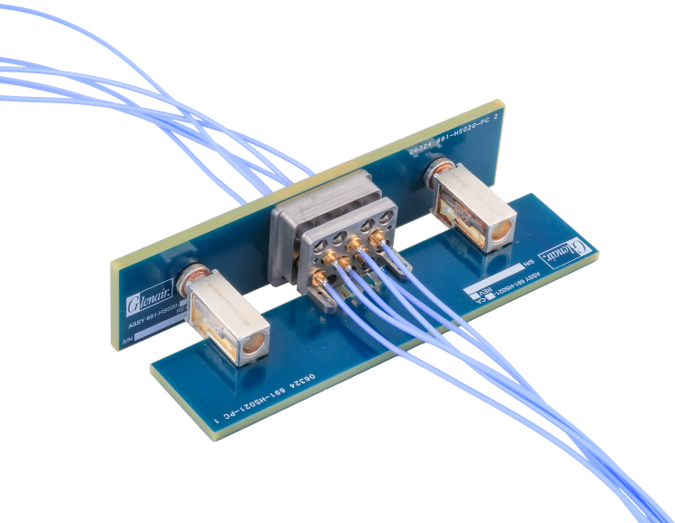
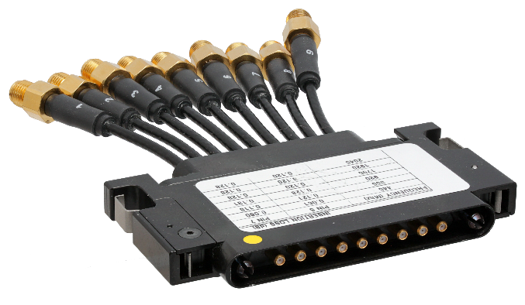

RF / Microwave Interconnect Assemblies
Low-loss cables · Multi-port connectors · High-frequency contacts
High-density rectangular
High-density circular
Board-level solutions

Slide 11
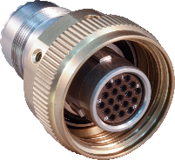
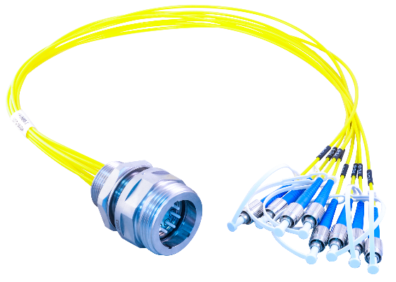
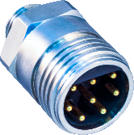
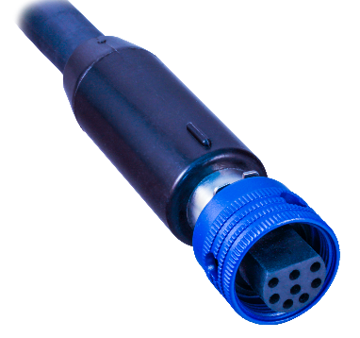
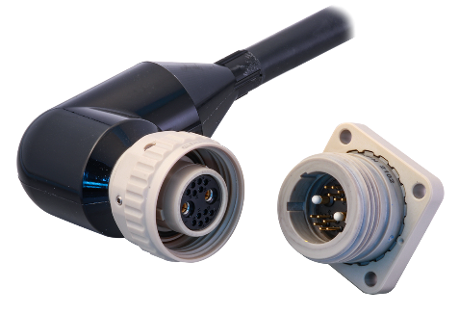
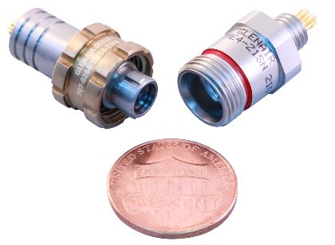
SeaKing™ High-Pressure Subsea Connectors
Electrical · Optical · Power · Turnkey Cables
SeaKing 700 10K psi metal and PEEK
SeaKing Fiber Optic open-face
pressure rated
Micro-PSI microminiature
10K psi subsea
SuperG55
high-performance COTS 10K psi

Slide 12
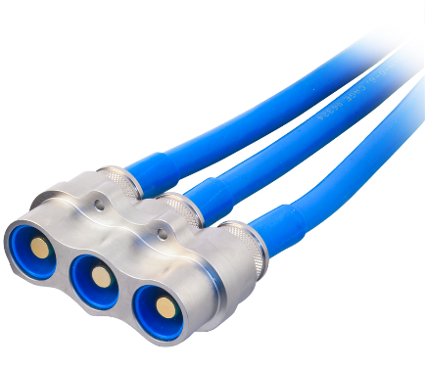
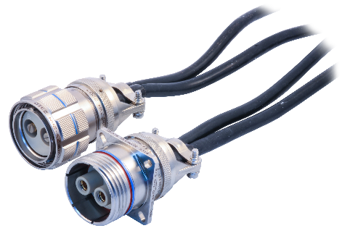
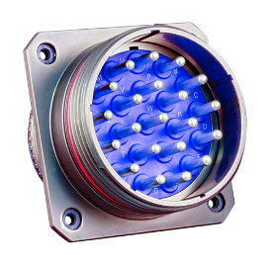
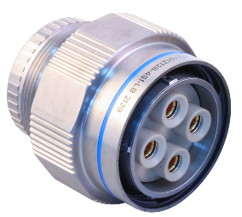
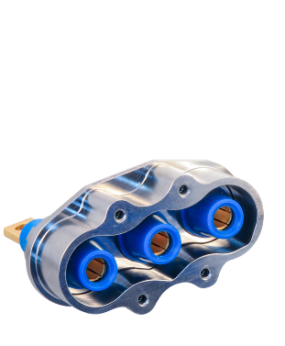
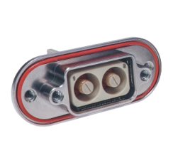
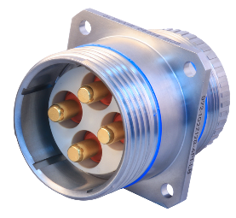
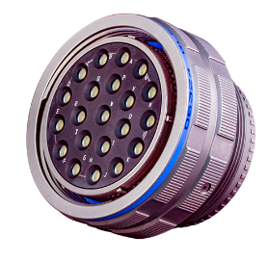
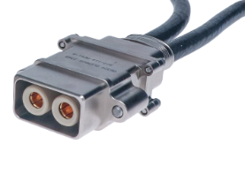

The TurboFlex® Ecosystem: High-Power Cables, Contacts, Connectors, and Assemblies
With Crown Ring low-temperature rise safe-touch contacts
PowerPlay circular and rectangular
PowerLoad HV
PowerTrip
high-density
MotorHead
fast assembly

Slide 13


Interconnect Technology for Electromagnetic Compatibility

Slide 14
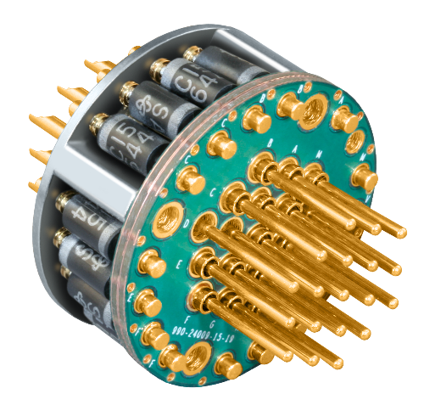
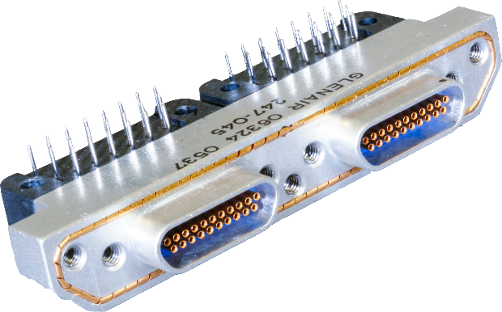
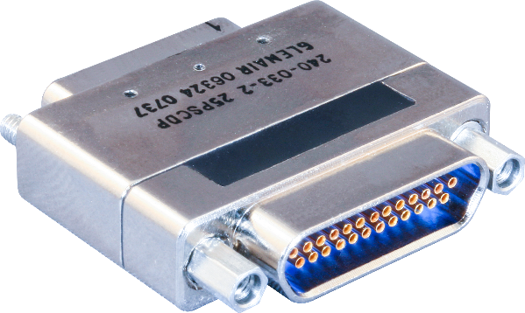

EMI / RFI and Transient Voltage Filters
Planar array and TVS diode · Total vertical integration
Miniaturized Micro-D packaging
Connector saver
designs
EMP / TVS diode
designs

Slide 15
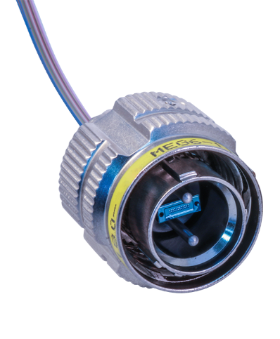
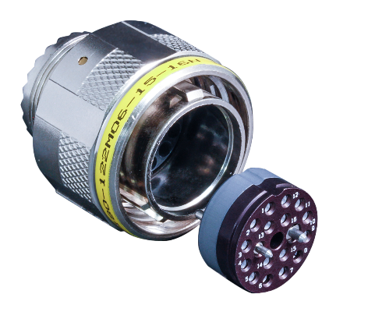
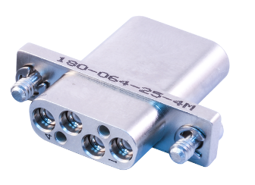
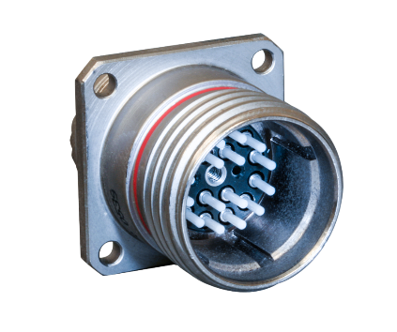
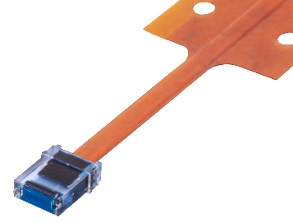
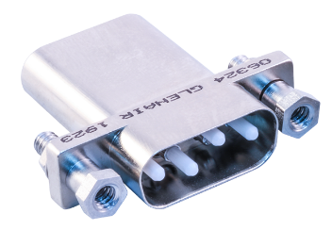
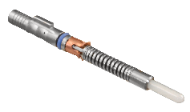

Rugged Fiber Optic Interconnect Systems
Complete EMI / RFI immunity · High datarate · Lightweight
MT Fiber Optic
ribbon / flex
Glenair High-Density
(GHD)
Glenair Front-Release
(GFR)

Slide 16






Lightweight Microfilament EMI Shielding
50%+ weight savings compared to legacy shielding
ArmorLite™
microfilament SS
ArmorLite™ CF
corrosion-free
AmberStrand®
composite

Slide 17




HighFlex Grounding Conductors
Ground straps · ESD bonds · Busbars
Flexible braided
ground straps
Short-length
ESD bonds
Multi-layer flexible
busbars

Slide 18








Band-Master ATS®
Six band types for every application
50% lighter and
lower-profile!
30% lighter and
lower-profile!
2X increase in clamping tension!

Slide 19




Small Form-Factor Interconnects for Size and Weight Reduction

Slide 20




Series 806 Mil-Aero
The lightweight micro circular with D38999 performance
High-density
multiport RF
High-density signal (bulkhead feed-thru)
Hybrid El Ochito
high-speed / signal

Slide 21








Mighty Mouse Connectors and Cables
Micro miniature connector series for optimized SWaP
67 tooled arrangements, 1 – 130 contacts
Six coupling styles
Harsh-environment,
EMI filter, high-speed
Turnkey mil-grade cordsets and assemblies

Slide 22












Series 79 Micro-Crimp Rectangular
Low-speed signal · High-speed 10GbE · RF / Microwave
HIGH-DENSITY
SCOOP-PROOF
HIGH-SPEED
DUAL-BAY
VERSALINK
RF/MICROWAVE

Slide 23






Series 882 SuperFly® Datalink Nano Miniature
Controlled-impedance · El Ochito shielded 10Gb Ethernet
Threaded-coupling
cable connectors
Push-pull
cable connectors
Straight and
right-angle PCBs

Slide 24




Harsh-Environmental
Aerospace and Missile Launch Connectors

Slide 25





SuperNine “Better-than-QPL” Mil-Qualified
All D38999 coupling styles
Series I
scoop-proof bayonet
Series II
low-profile bayonet
Series III
triple-start
Series IV
breech-lock

Slide 26





SuperNine “Better-than-QPL” Mil-Qualified
Low-speed signal · High-speed · RF · Thermocouple
Standard and high-density crimp and PCB
High-speed
shielded
High-frequency RF
Thermocouple

Slide 27






Glass-to-Metal Sealed Hermetic Connectors
The gold standard of environmental protection
Rectangular configurations
Bulkhead
feed-thrus
Circular
MS-type
Custom
configurations

Slide 28


CODE RED Hermetic Connectors
Lightweight · Encapsulant-sealed · Low-resistance

Slide 29






ThermaRex™
Cryogenic and high-temperature interconnects
260°C
High-Temperature
-195°C
Cryogenic
Thermal dissipation straps
Conduit and flexible braided shielding

Slide 30





Missile Launch Interconnect Solutions
Lanyard-release · Missile umbilical · High-pressure cooling
MIL-DTL-38999 type lanyard-release
Blind-mate, Assisted Separation, and Dead-Face
Fire control and missile launch connectors

Slide 31




High-Density Rectangular Cable, Board, and Backplane Connectors

Slide 32




AlphaLink
Rugged I/O to spring-pin contact connectors and flex assemblies
Series 89 Rectangular Nanominiature-to-AlphaLink SL flex jumper (rear-panel-mount plug or receptacle)
^{High-reliability Micro-D}
MIL-DTL-83513 type rectangular-to-AlphaLink SL flex jumper
^{AlphaLink-to-AlphaLink}
^{board-to-board}
^{flex jumper assembly}

Slide 33




MIL-DTL-55302 Type Board and I/O-to-Board Connectors
Standard .100" contact spacing with #22 contacts
Vertical
Right-Angle
Solder-cup
Flex
Notes:
Standard-density I/O-to-board and board-mount rectangular connectors for mission-critical aerospace applications. Contacts are set on two rows with .100 centers, comparable to AirBorn Series W connectors.

Slide 34




VITA 66.1 Backplane Connectors
Blind-mate optical MT / RF connector system IAW VITA 66.1 / 66.4
Right-angle configuration for motherboard/daughtercard applications
High-density MT with up to 24 channels per ferrule
VITA 67.3 SMPM and SMPS RF connectors

Slide 35






LRM Brush Contact BackplaneConnectors
Re-engineered for zero FOD, zero electrical discontinuity
Fully-tooled brush contacts
Compliant pin
board termination
Modular design supports signal, RF, and power
Interoperable with Amphenol

Slide 36




HD Stacker High-Density Board-to-Board
Vibration and shock-resistant compliant pin contact system
Solder-free (compliant pin) board mounting
.0625" pitch contact spacing: highest available density
Polarized shells
and guide pins
prevent mismating

Slide 37







Micro-D Subminiature: QPL and Glenair Signature
With high-vibration and shock-resistant TwistPin contacts
Splice-free cable assemblies
Shielded and unshielded pigtail assemblies
Signature
PCB-mount connectors
Micro and hybrid
flex assemblies

Slide 38






Glenair Modular Micro-D (GMMD)
Signal · Power · RF · High-speed · Standard Micro-D footprint
High-speed twinax
plus signal
RF coax plus signal
Spring-loaded coax
PCB termination

Slide 39







Nanominiature: QPL and Glenair Signature
Rectangular and circular designs · Nano TwistPin contacts
The smallest and lightest mil-spec connector
Nano pigtails and
point-to-point jumpers
Straight and right-angle nano PCB

Slide 40



Innovative Wire Protection Connector Accessories

Slide 41








Environmental Connector Accessories
Auxiliary sealing and wire protection
ProSeal
protective covers
Heat- and cold-
shrink boots
Wire and cable sealing backshells
Conduit wire
protection systems

Slide 42




Swing-Arm® Cable Clamp EMI / RFI Backshell
Articulating 3-in-1 strain relief and cable shield terminator
Drop-in follower
version
Aluminum, composite, and stainless steel
Shield sock
assemblies

Slide 43
Unmanned and Collaborative Combat System Interconnect Solutions
Connectors and Assemblies for Autonomous Battlespace Applications
Notes:
SWaP optimization
extreme shock and vibration resistance
high-speed data
power distribution
EMI protection
sealed interconnects
rapid production scalability
harsh-environment survivability

